Slide 1
Empowering Azure Storage with RDMA
Wei Bai
Presenting collective work of many teams in Microsoft
Peking University
Notes:
Hello everyone, I am very happy to be here to present collective work of Azure and MSR on RDMA networking

Slide 2
Project Contributors
Wei Bai, Shanim Sainul Abdeen, Ankit Agrawal, Krishan Kumar Attre, Paramvir Bahl, Ameya Bhagat, Gowri Bhaskara, Tanya Brokhman, Lei Cao, Ahmad Cheema, Rebecca Chow, Jeff Cohen, Mahmoud Elhaddad, Vivek Ette, Igal Figlin, Daniel Firestone, Mathew George, Ilya German, Lakhmeet Ghai, Eric Green, Albert Greenberg, Manish Gupta, Randy Haagens, Matthew Hendel, Ridwan Howlader, Neetha John, Julia Johnstone, Tom Jolly, Greg Kramer, David Kruse, Ankit Kumar, Erica Lan, Ivan Lee, Avi Levy, Marina Lipshteyn, Xin Liu, Chen Liu, Guohan Lu, Yuemin Lu, Xiakun Lu, Vadim Makhervaks, Ulad Malashanka, David A. Maltz, Ilias Marinos, Rohan Mehta, Sharda Murthi, Anup Namdhari, Aaron Ogus, Jitendra Padhye, Madhav Pandya, Douglas Phillips, Adrian Power, Suraj Puri, Shachar Raindel, Jordan Rhee, Anthony Russo, Maneesh Sah, Ali Sheriff, Chris Sparacino, Ashutosh Srivastava, Weixiang Sun, Nick Swanson, Fuhou Tian, Lukasz Tomczyk, Vamsi Vadlamuri, Alec Wolman, Ying Xie, Joyce Yom, Lihua Yuan, Yanzhao Zhang, Brian Zill, and many others
Technical support from Arista Networks, Broadcom, Cisco, Dell, Keysight, NVIDIA
Notes:
This is the agenda of my talk today

Slide 3
Agenda
Background
RDMA Deployment for Azure Storage
Problems, Lessons and Future Directions
Notes:
This is the agenda of my talk today

Slide 4
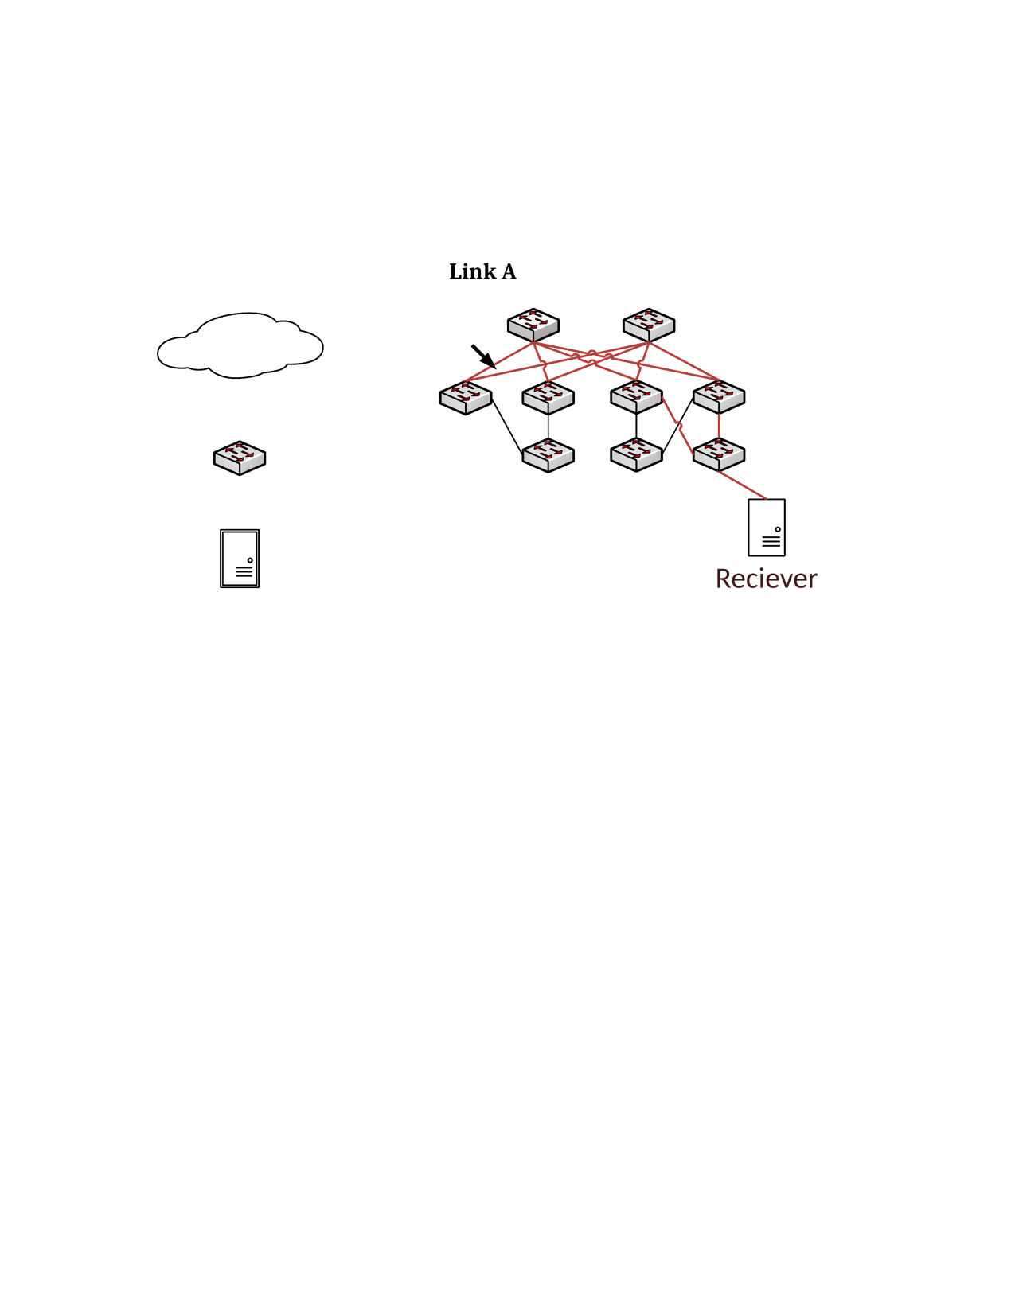
Remote Direct Memory Access (RDMA)
Memory
Allocate
Buffer A
DMA
Application
Write local buffer at address A to remote buffer at address B
Requester
Responder
Buffer B is filled
Application
Memory
Buffer B
DMA
Allocate
RDMA bypasses host OS stack
→ frees host CPU, lowers latency
Notes:
Let’s start with basic concept of RDMA. I think many of you know DMA, direct memory access. This is a feature that allows certain hardware subsystems to access main memory independently of CPU. RDMA is essentially remote DMA that crosses different machines.
In this example, there are two hosts which are connected by the network. The requester application tells its NIC ‘hey, can you send data I store in local buffer A to a remote buffer B’.
[click]
The requester’s NIC fetches data from host memory using DMA without involvement of CPU, assemble data into packets, and [click] send packets to the destination NIC through the network.
[click]
Then destination NIC de-assemble packets to get data, writes data to the memory B, and tells the responder application “Hey, someone writes something to your buffer B”
[click]
This data exchange process does not involve network stack running in OS kernel, thus freeing CPU cores. Compared to OS network stack, NIC hardware can provide much lower processing latency and better throughput.

Slide 5
Performance Benefits of RDMA
RDMA single thread ~40Gbps
RDMA CPU ~0%
RDMA latency 1~2 μs
Measurement on Mellanox ConnectX-3 Pro 40Gbps NIC
Latest RDMA NICs can achieve 200Gbps/400Gbps for a single flow
Credit: Zhu et al. “Congestion Control for Large-Scale RDMA Deployments” in SIGCOMM 2015

Slide 6
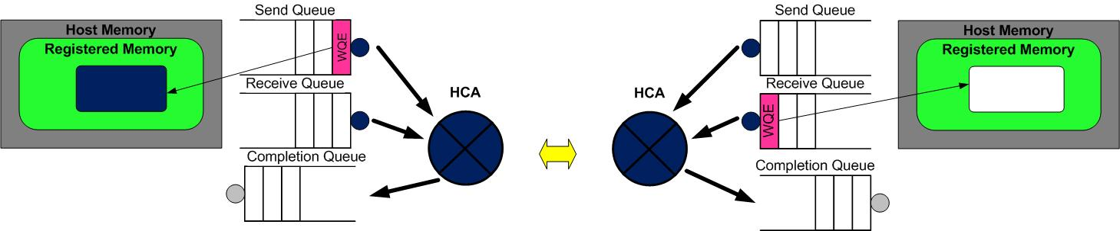
RDMA Programming Model
Queue Pair = Send Queue + Receive Queue
Verbs: send, receive, write and read
HCA = Host Channel Adapter = NIC

Slide 7
RDMA Networking Techniques
InfiniBand (IB)
Widely used in super computers.
Lossless networks
Special hardware which is incompatible with Ethernet/IP
iWARP
Deliver RDMA services over TCP/IP
Vanilla lossy Ethernet
Expensive & Bad performance due to high complexity
RoCE (v2)
RDMA over converged Ethernet
Lossless Ethernet
Cheap & Good performance
Notes:
There are mainly three types of RDMA techniques.

Slide 8
RDMA Networking Techniques
iWARP
Deliver RDMA services over TCP/IP
Vanilla lossy Ethernet
Expensive & Bad performance due to high complexity
RoCE (v2)
RDMA over converged Ethernet
Lossless Ethernet
Cheap & Good performance
InfiniBand (IB)
Widely used in super computers.
Lossless networks
Special hardware which is incompatible with Ethernet/IP
RoCE (v2)
RDMA over converged Ethernet
Lossless Ethernet
Cheap & Good performance
Suitable for datacenter-scale deployments
Notes:
There are mainly three types of RDMA techniques.

Slide 9
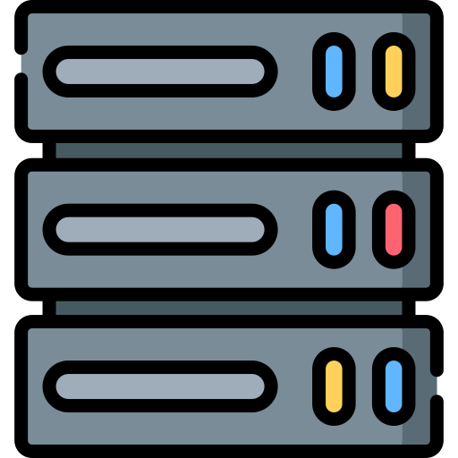
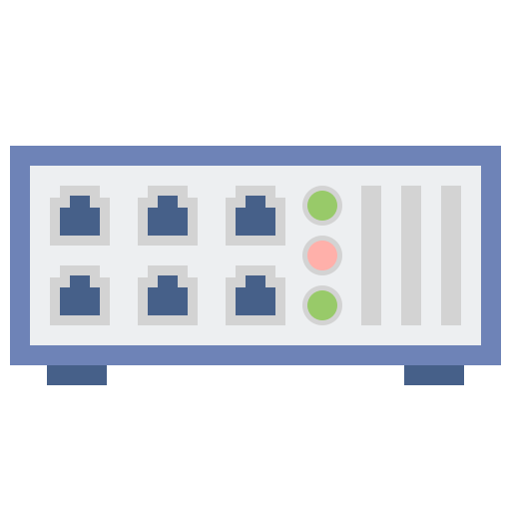
RoCE is not resilient to losses like TCP*
Experiment setup:
The sender keeps transmitting 10KB messages back-to-back over a persistent connection
Sender
Tofino Switch
Receiver
NVIDIA CX4 NIC
NVIDIA CX4 NIC
 | No drop | Drop 1st packet of the message
TCP | 64us | 159us
RDMA | 5.75us | 199us
Message completion times in difference scenarios
*Recent RDMA NICs such as NVIDIA CX5 and CX6 have significantly improved retransmission performance
Notes:
However, RDMA is not resilient to losses like TCP. In this experiment, we have two CX4 nodes connected to a Tofino programmable switch. When there is no packet drop, as we can see, RDMA significantly outperforms TCP. But if we program the switch to drop the first packet of every message, RDMA’s performance is even poor than TCP due to very slow retransmission in hardware

Slide 10
Basic Challenges of RoCE
RoCE assumes a lossless network, but packet loss happens in DCs today and is used by TCP to infer congestion
Option: Use Priority-based Flow Control (PFC), which is supported by Ethernet switches, to eliminate congestion loss
Data Packet
XOFF Threshold
Prio 1
Prio 1
Prio 2
Prio 2
Pause Frame
Egress Port
Ingress Port
Notes:
RoCE assumes a lossless network. However, we know that packet loss due to congestion is common in datacenters today and this is used by TCP as the important signal to infer congestion.
[click] To eliminate congestion lossless in datacenters, one option is using priority-based flow control, which is supported by Ethernet switches in our datacenters.
This figure shows how PFC works. There are two priorities each with a XOFF threshold. If the ingress queue length reaches the Xoff threshold, the switch sends red pause frame to the upstream device to tell it to stop sending data.

Slide 11
Problems of PFC
Head-of-line (HOL) blocking
Data packets
Flow1: port 1 -> port 4
Flow2: port 2 -> port 4
Flow3: port 1 -> port 3
Switch
Port 1
Port 3
Flow 3
Flow 1
Port 2
Port 4
Flow 2

Slide 12

Problems of PFC
Head-of-line (HOL) blocking
Data packets
Flow1: port 1 -> port 4
Flow2: port 2 -> port 4
Flow3: port 1 -> port 3
PFC
Switch
Port 1
Port 3
The switch sends PFC pause frames from port 1 and 2
Flow 3
Flow 1
Port 2
Port 4
Flow 2

Slide 13
Problems of PFC
Head-of-line (HOL) blocking
Data packets
Flow1: port 1 -> port 4
Flow2: port 2 -> port 4
Flow3: port 1 -> port 3
PFC
Switch
Port 1
Port 3
The switch sends PFC pause frames from port 1 and 2
Flow 3
Flow 1
Flow 3 is paused though it does not create any congestion!
Port 2
Port 4
Flow 2

Slide 14
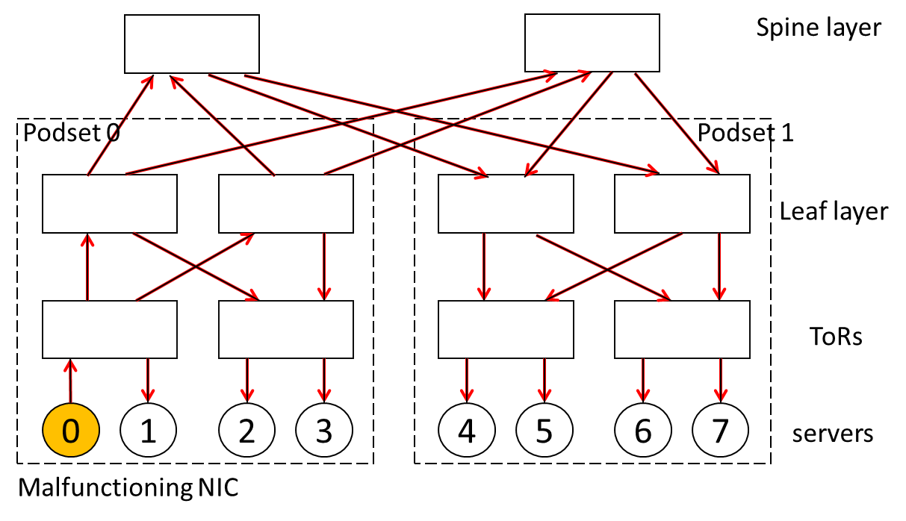
Problems of PFC
Head-of-line (HOL) blocking
Mad NICs and switches send PFC frames when there is no congestion
Credit: Chuanxiong Guo “RDMA in Data Centers: Looking Back and Looking Forward” in APNet 2017

Slide 15
Problems of PFC
PFC can spread congestion, is unfair, and
can lead to deadlocks!
Zhu et al. [SIGCOMM’15], Guo et al. [SIGCOMM’16], Hu et al. [HotNets’17]
Head-of-line (HOL) blocking
Mad NICs and switches send PFC frames when there is no congestion
Credit: Chuanxiong Guo “RDMA in Data Centers: Looking Back and Looking Forward” in APNet 2017

Slide 16
Agenda
Background
RDMA Deployment for Azure Storage
Problems, Lessons and Future Directions
Notes:
This is the agenda of my talk today

Slide 17
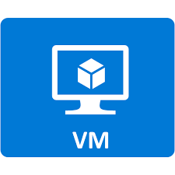

Disaggregated Storage in Azure
Azure Compute
Azure Storage

Slide 18
Disaggregated Storage in Azure
Backend
Frontend
Azure Compute
Azure Storage

Slide 19
Disaggregated Storage in Azure
Frontend
Storage
Disk Write Request
Disk Write Response
VM1
VM2
Partition Server
Host Domain
Compute Server
Extent Node
Extent Node
Extent Node
Primary
Secondary
Secondary

Slide 20
Disaggregated Storage in Azure
RDMA
Backend
Frontend
Azure Compute
Azure Storage

Slide 21
RDMA Benefits benefits
For Azure
Sell freed-up CPU cores in compute
For Customers
Buy cheaper servers in storage
Lower IO latency and jitter
Core savings

Slide 22

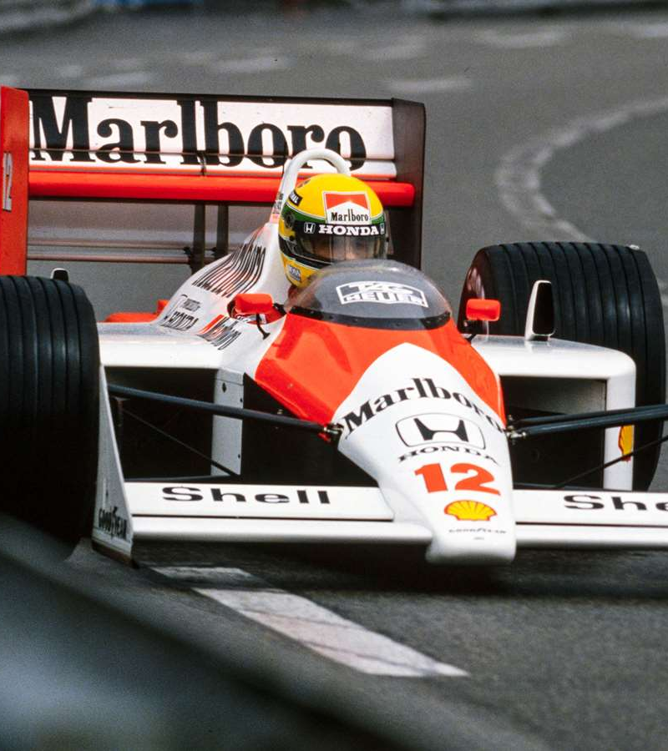
TCP
RDMA
Credit: Jitu Padhye
Notes:
This is a good analogy for TCP and RDMA. TCP is as slow as my Honda CRV and RDMA is like F1 race car.

Slide 23
Network Architecture of an Azure Region
Regional Hub
Data Center
T2
Cluster
T1
T0
Server
Notes:
This figure gives the topology of an Azure region. Green ones are servers. Then there are four tiers of switches, T0, T1, T2 and RH.

Slide 24
Azure needs intra-region RDMA
RDMA
Regional Hub
T2
T1
T0
Server
Compute
Storage
Compute
Storage
Notes:
In Azure, a compute VM can fetch the blob from any storage cluster inside the region. Therefore, RDMA traffic may cross different datacenters.

Slide 25
Large and variable latency end-to-end
Intra-rack RTT: 2us
Intra-DC RTT: 10s of us
Intra-region RTT: 2ms
Regional Hub
Up to 100km
500us delay
T2
300m
T1
40m
T0
5m
Server
Notes:
This means our RDMA traffic will experience a large RTT variation due to long haul cables between T2 and RH.

Slide 26
Heterogenous NICs
Different types of NICs have different transport (e.g., DCQCN) implementations
Regional Hub
T2
T1
T0
Gen1
Gen1
Gen2
Gen3
Server
Notes:
We also need to handle heterogenous NIC hardware.
[click]
In Azure, different clusters use different hardware. Old clusters use CX3 while the new ones use CX4 and CX5. And they have different DCQCN implementations.

Slide 27
Heterogenous Switches
Regional Hub
Multi-ASIC Deep-buffered Chassis Switches
T2
Single-ASIC Shallow-buffered Pizza Box Switches
T1
T0
Server
Notes:
In addition to NIC, our switches are also heterogenous. At the high level, we can classify our data center switches into two categories. [click] At T0 and T1, ,[click] At T2 and RH

Slide 28



Heterogenous Switches
Multi-ASIC Deep-buffered Chassis Switches
Regional Hub
Many vendors
T2
Single-ASIC Shallow-buffered Pizza Box Switches
T1
T0
Server
Notes:
And all the cloud providers want to avoid vendor lock-in problem. So we use switches from different vendors.

Slide 29
Our Solutions in 1 Slide
RDMA-based protocols: sU-RDMA and sK-RDMA
Host monitoring: RDMA Estats
Unified switch software: SONiC
Congestion control: DCQCN + PFC

Slide 30
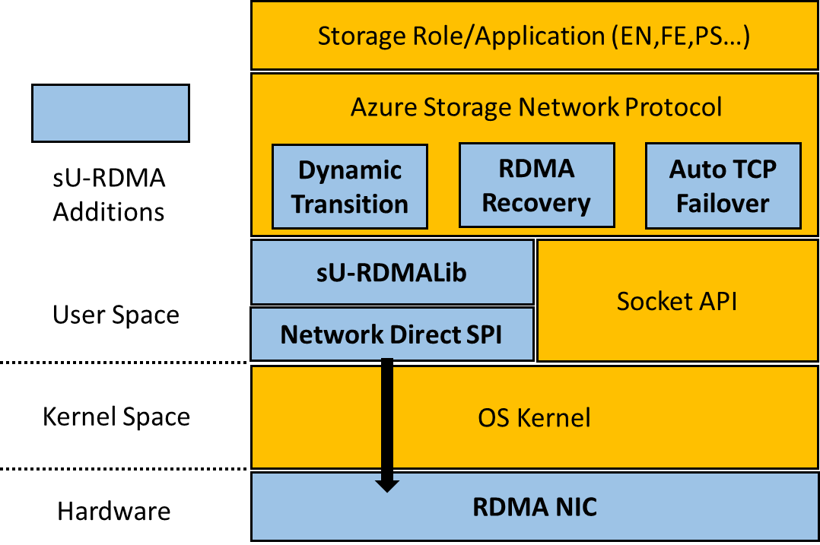
sU-RDMA* for Storage Backend
Translate Socket APIs to RDMA verbs
Three transfer modes based on message sizes
TCP and RDMA transitions
If the NIC becomes “mad”, we should switch to TCP
After some time, we should try recovering back to RDMA.
Chunking: static window
*sU-RDMA = storage user space RDMA

Slide 31
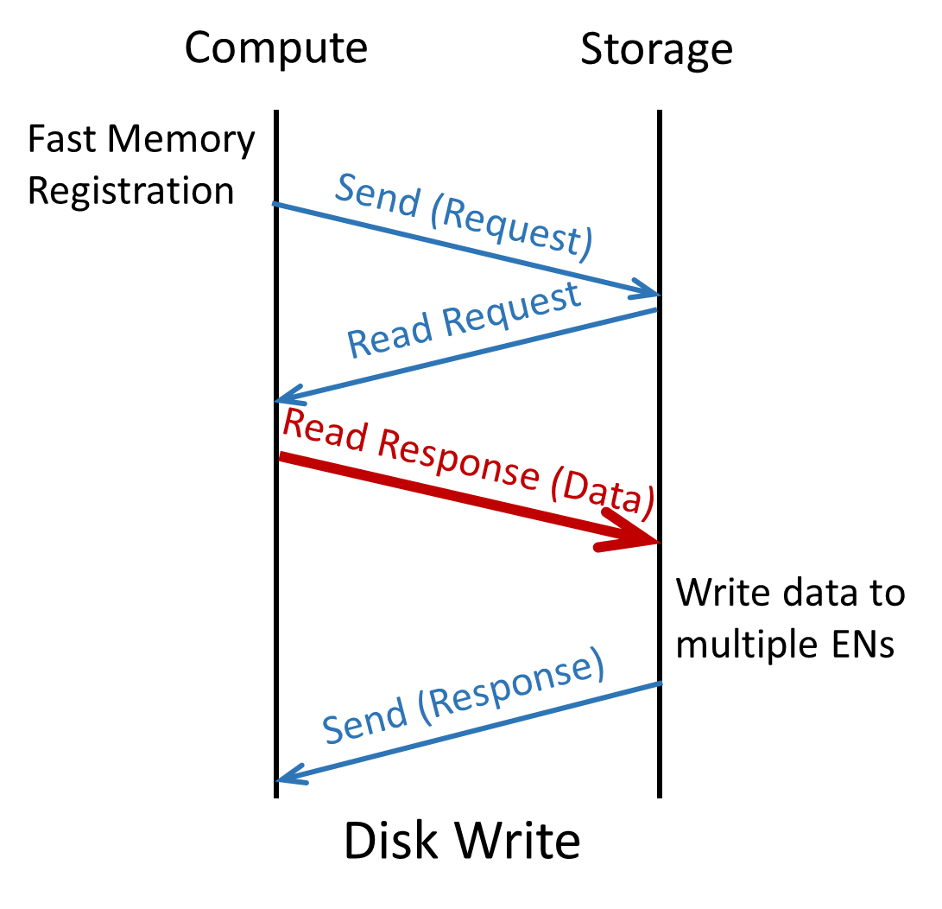
sK-RDMA* for Storage Frontend
Extend SMB Direct. Run RDMA in kernel space.
According to IB spec, the NIC should wait for the completion of the FMR before processing any subsequently posted requests
*sK-RDMA = storage kernel space RDMA

Slide 32
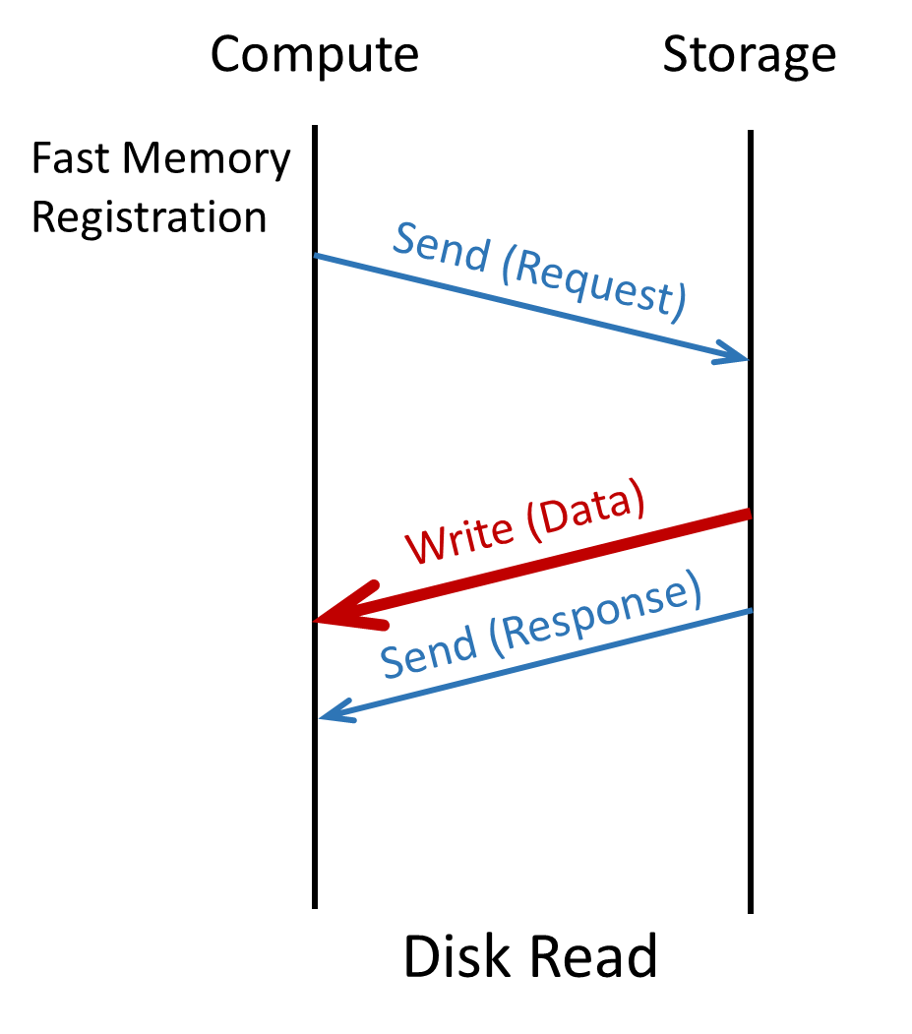
sK-RDMA* for Storage Frontend
Extend SMB Direct. Run RDMA in kernel space.
Read from any EN
*sK-RDMA = storage kernel space RDMA

Slide 33
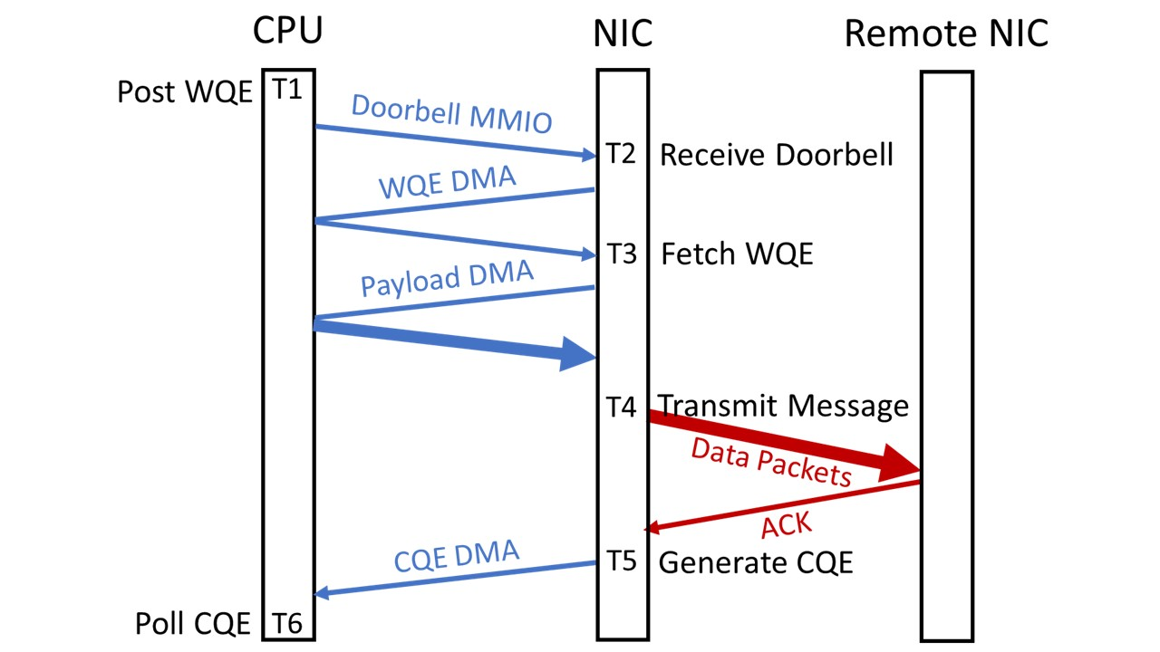
RDMA Estats
Provide fine-grained latency breakdown for each RDMA operation
T6 - T1: client latency
T5 - T1: hardware latency

Slide 34
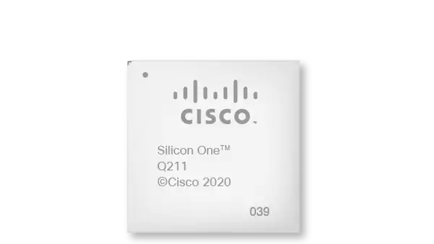
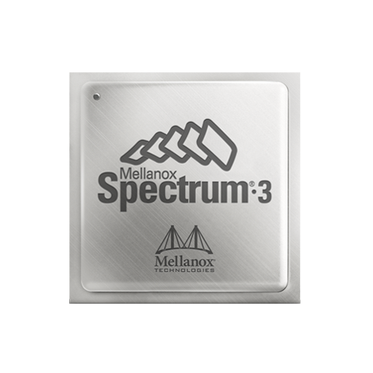

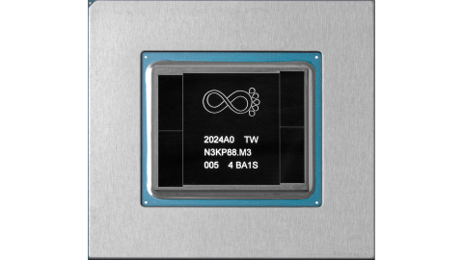
Traditional Switch Ecosystem
ASIC Vendor
Notes:
A switch essentially consists of ASIC and switch OS software, which controls the ASIC.
Representative switch ASIC vendors include ..

Slide 35
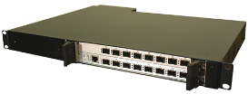
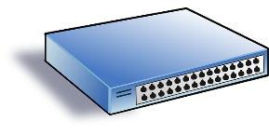
Traditional Switch Ecosystem
Proprietary Switch OS
Arista EOS
Cisco IOS
Switch Box
Switch Vendor
ASIC Vendor
Notes:
Switch vendors buy ASICs, build the switch OS to control ASICs. These switch OSs are not open sourced. And most importantly, the switch Oses are typically very complex because they includes the union of all features requested by all customers over the lifetime of the product.

Slide 36




Traditional Switch Ecosystem
Cloud Provider
Switch Vendor
ASIC Vendor
Notes:
To avoid vendor lock-in problem, cloud providers adopt switches from multiple vendors

Slide 37

Traditional Switch Ecosystem
Cloud Provider
Low Visibility
Switch Vendor
ASIC Vendor

Slide 38



SONiC: Software for Open Networking in the Cloud
New
More apps
SNMP
BGP
DHCP
BGP
IPv6
New
Database
Platform
TeamD
LLDP
A Containerized Cross-platform Switch OS
SWSS
Utility
RedisDB
SYNCD
ASIC Vendor
Notes:
SONiC stands for ..
SAI provides unified interfaces and behavior models for the switch. ASIC vendors provide implementations of SAI. SAI enables switch OS to use a universal language to talk to different vendors.
SONiC is built on the top of SAI.

Slide 39
SONiC: Software for Open Networking in the Cloud
Cloud Provider
using SONiC
Open Software
+
Standardized Hardware Interfaces
New
More apps
SNMP
BGP
DHCP
BGP
IPv6
New
Database
Platform
TeamD
LLDP
A Containerized Cross-platform Switch OS
SWSS
Utility
RedisDB
SYNCD
ASIC Vendor
Notes:
SONiC stands for ..
SAI provides unified interfaces and behavior models for the switch. ASIC vendors provide implementations of SAI. SAI enables switch OS to use a universal language to talk to different vendors.
SONiC is built on the top of SAI.

Slide 40
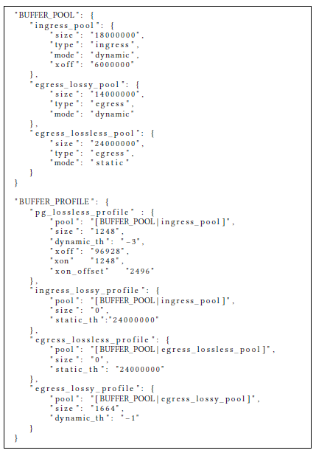
RDMA Features in SONiC
ECN
Shared buffer
PFC
PFC headroom pool
PFC watchdog
Various counters
A SONiC Buffer Template Example
Notes:
When we design SONiC, we take RDMA required features into consideration from the day one.
But given these features, how to test them? How to ensure they work as expected?

Slide 41
RDMA Features in SONiC
ECN
Shared buffer
PFC
PFC headroom pool
PFC watchdog
Various counters
A SONiC Buffer Template Example
If a queue has been in paused state for very long time, drop all its packets
Notes:
When we design SONiC, we take RDMA required features into consideration from the day one.
But given these features, how to test them? How to ensure they work as expected?

Slide 42


How to test RDMA features of SONiC
Software-based tests (single step debugging)
Block the transmission of a switch port
Inject a series of packets destined for the blocked port and capture snapshots of switch states accordingly
Release the port and dump packets
If queue length == 1

Slide 43
How to test RDMA features of SONiC
Software-based tests (single step debugging)
Block the transmission of a switch port
Inject a series of packets destined for the blocked port and capture snapshots of switch states accordingly
Release the port and dump packets
If queue length == 2

Slide 44
How to test RDMA features of SONiC
Software-based tests (single step debugging)
Block the transmission of a switch port
Inject a series of packets destined for the blocked port and capture snapshots of switch states accordingly
Release the port and dump packets
If queue length == 3

Slide 45
How to test RDMA features of SONiC
Software-based tests (single step debugging)
Block the transmission of a switch port
Inject a series of packets destined for the blocked port and capture snapshots of switch states accordingly
Release the port and dump packets
If queue length == 4 and
ECN counter == 1
ECN marking

Slide 46
How to test RDMA features of SONiC
Software-based tests (single step debugging)
Block the transmission of a switch port
Inject a series of packets destined for the blocked port and capture snapshots of switch states accordingly
Release the port and dump packets
Features covered: buffer model, watermark, scheduling, etc.
Limitation: cannot test performance-sensitive features

Slide 47
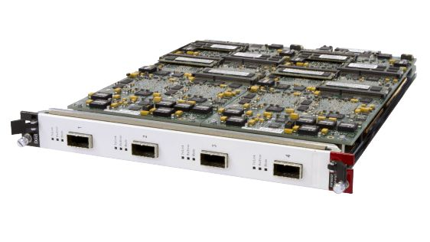
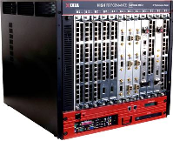
How to test performance-sensitive features
Control traffic generation at μs and ns timescales
High-resolution measurement of data plane behaviors
Our solution: programmable test hardware from Keysight

Slide 48
DCQCN uses Explicit Congestion Notification (ECN) as early-warning
DCQCN is a rate-based congestion control algorithm implemented in NIC
Marked Packets
Sender
Congestion
Receiver
Congestion Notifications
Sender lowers rate when notified of congestion and increases o/w
We use both DCQCN and PFC:
DCQCN reduces how often PFC is triggered.
PFC is still used as the last resort.
Notes:
Given these observations, together with Azure networking and Mellanox, we design DCQCN, a rate-based congestion control algorithm implemented in the NIC. Instead of sensing congestion through packet losses, DCQCN uses explicit congestion notification supported by commodity Ethernet switches to detection congestion and avoid packet losses as much as possible.
[click]
This example shows how DCQCN works. When there is congestion, there must be some queue build-ups in the switch buffer. [click] Let’s assume the marking threshold is 3. So the fourth packet in the buffer will be marked. [click] When the receiver sees this marked packet, it will know that there is congestion in the network and send a special kind of packets, called congestion notification packets, to tell the sender.
[click]
The sender lowers rate when it receives congestion notification packets. Otherwise, it will increase the sending rate.
[click]
We use both DCQCN and PFC in our deployments. We rely on DCQCN to eliminate packet losses in common cases and use PFC as the last resort to handle extreme cases.

Slide 49
DCQCN + PFC in Production
Different DCQCN implementations on NIC Gen1/2/3
Gen1 has DCQCN implemented in firmware (slow) and uses a different congestion notification mechanism.
Solution: modify firmware of Gen2 and Gen3 to make them behave like Gen1
Careful DCQCN tuning for a wide range of RTTs
Interesting observation: DCQCN has near-perfect RTT fairness
Careful buffer tuning for various switches
Reserve enough PFC headroom, especially for long cables
Ensure that ECN kicks in before PFC

Slide 50
Deployment Practice
Lab Testbed
Test each individual component
DCQCN tuning
Test Clusters
End-to-end stress tests (high load, error injection, different servicing flows)
Finalize DCQDN parameters
Production Clusters
Minimize the impact of servicing switches and NICs to customer traffic

Slide 51
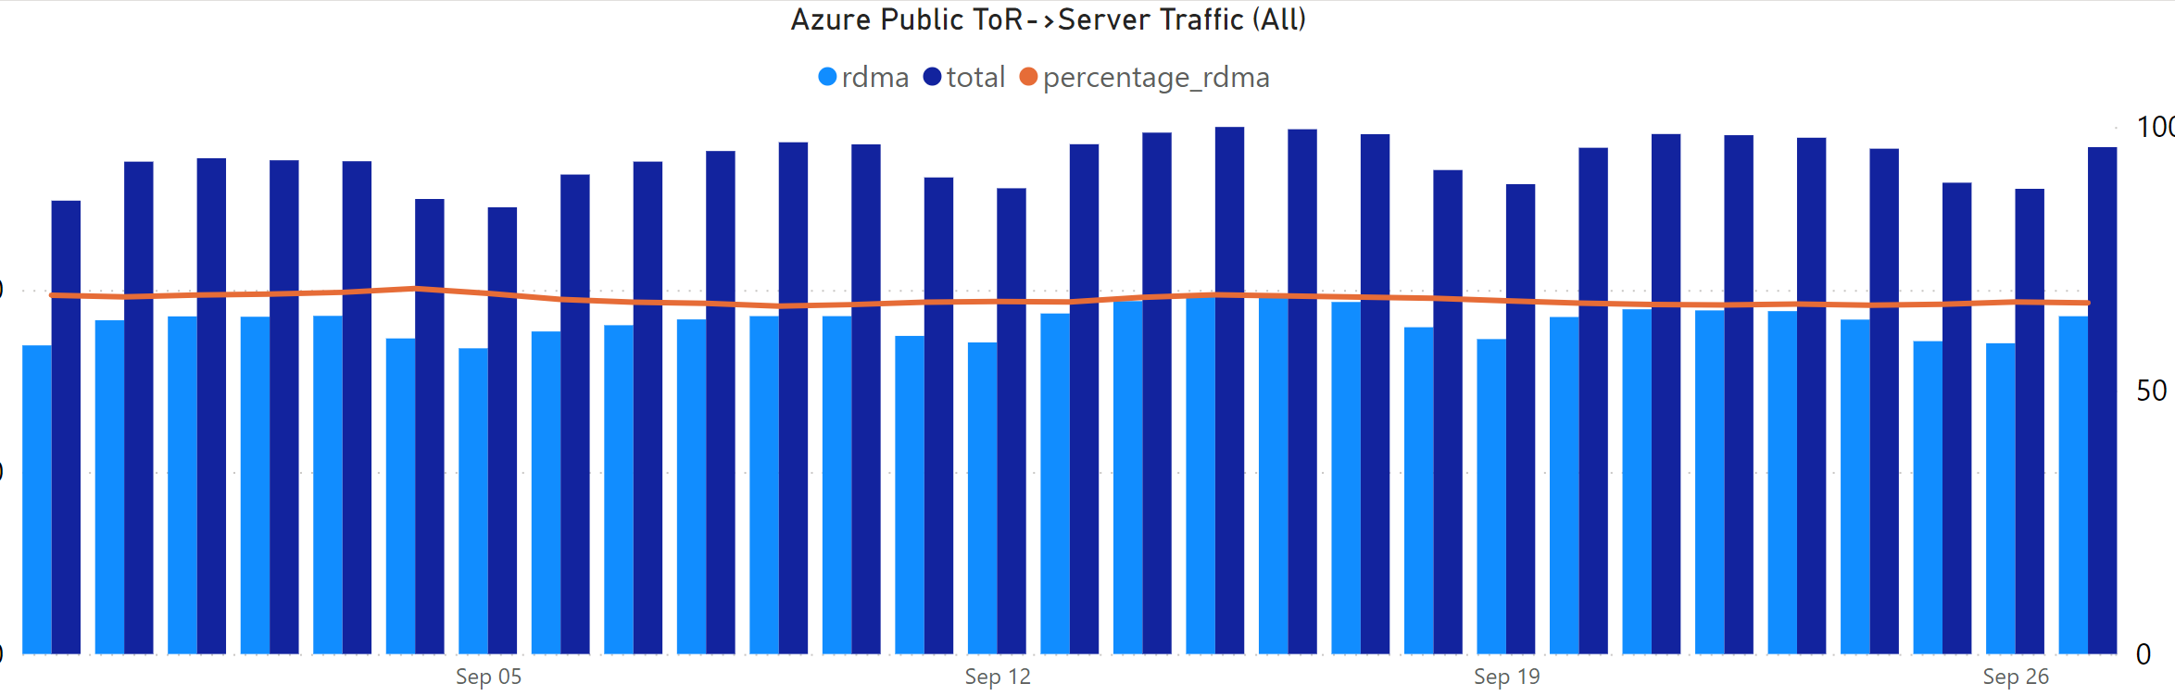
100x100 100 Gbps over 100 km
O(10¹⁸) bytes / day, O(10⁹) IOs / day
~70% of bytes. TCP distant second.
Significant perf improvements and COGS savings
Possibly largest RDMA deployment in the world

Slide 52
Agenda
Background
RDMA Deployment for Azure Storage
Problems, Lessons and Future Directions
Notes:
This is the agenda of my talk today

Slide 53
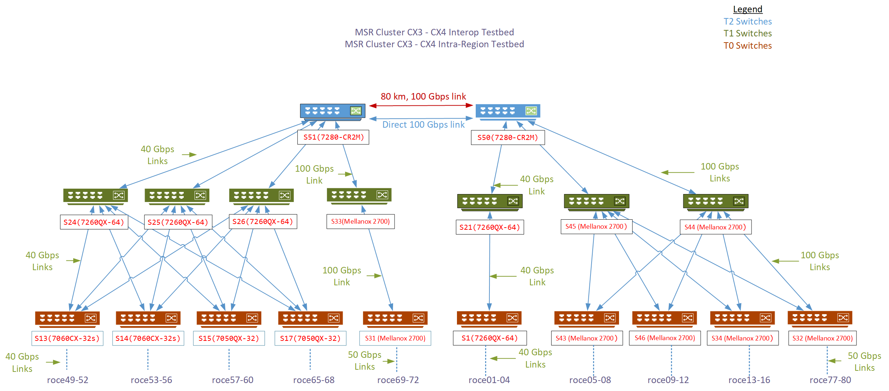
Case Study: a DCQCN implementation bug
Gen1 (40G)
Gen2 (50G)
Notes:
This is part of our testbed.
[click]
We use a dumbbell topology with two racks of servers to run all to all workloads.

Slide 54
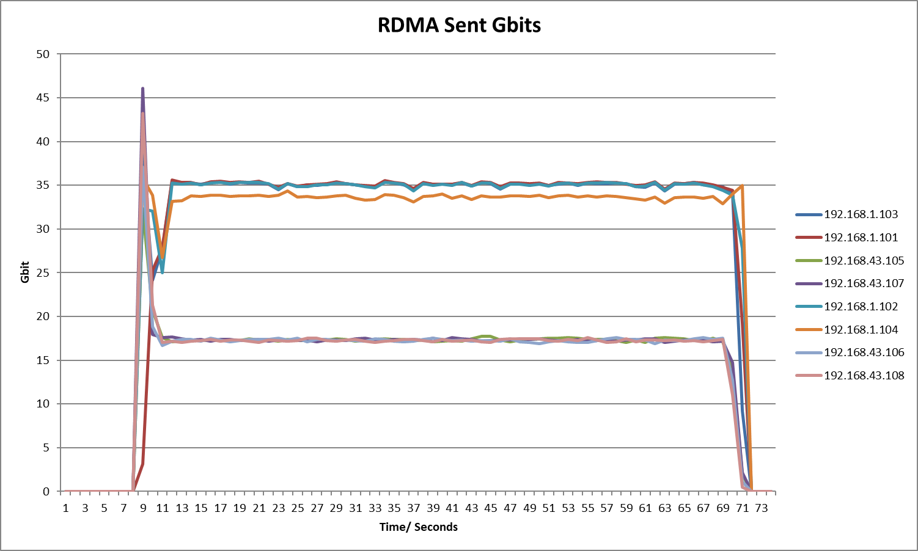
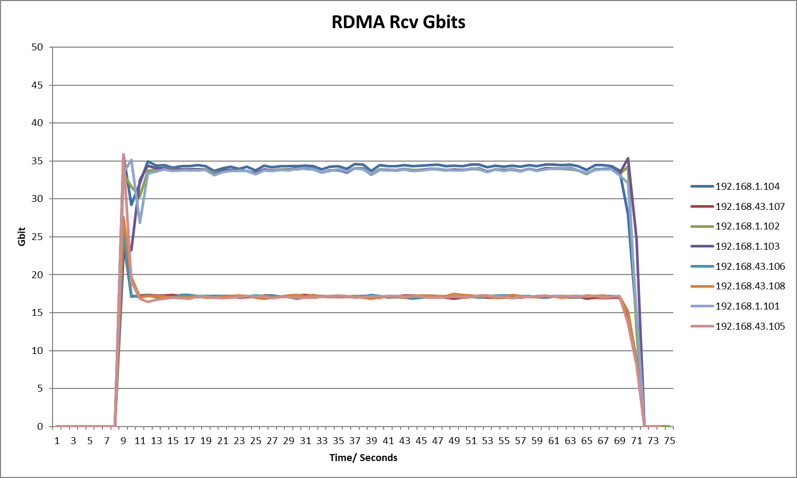
Discovering the problem
8 Hosts: 4 with Gen1 NIC (40Gbps), 4 with Gen2 NIC (50 Gbps)
All-to-all traffic pattern, 10 QPs per host pair, RDMA Write
Gen1: 34Gbps goodput
Gen1: 34Gbps goodput
Gen2: 17Gbps goodput
Gen2: 17Gbps goodput
Aggregate goodput: 200.6Gbps

Slide 55
Analysis
Max-min fairness to predict throughput in MSR cluster
All hosts should be sending & receiving at line rate
Expected aggregate throughput per host-pair
Gen1 to Gen1: 10Gbps
Gen1 to Gen2: 2.5Gbps
Gen2 to Gen1: 2.5Gbps
Gen2 to Gen2: 13.3Gbps
Notes:
So what is the problem here? We use our domain knowledge to analyze this problem. We know that DCQCN should be able to achieve max-min fairness in such scenarios. So we use water-filling algorithm to derive the expected throughput for each host pair.

Slide 56
Analysis
Max-min fairness to predict throughput in MSR cluster
All hosts should be sending & receiving at line rate
Expected aggregate throughput per host-pair
Gen1 to Gen1: 10Gbps
Gen1 to Gen2: 2.5Gbps
Gen2 to Gen1: 2.5Gbps
Gen2 to Gen2: 13.3Gbps 2.5Gbps
Finding: Gen2’s sending rate is limited by rate of the slowest receiver
The vendor found a HoL blocking firmware bug in Gen2 NIC.

Slide 57
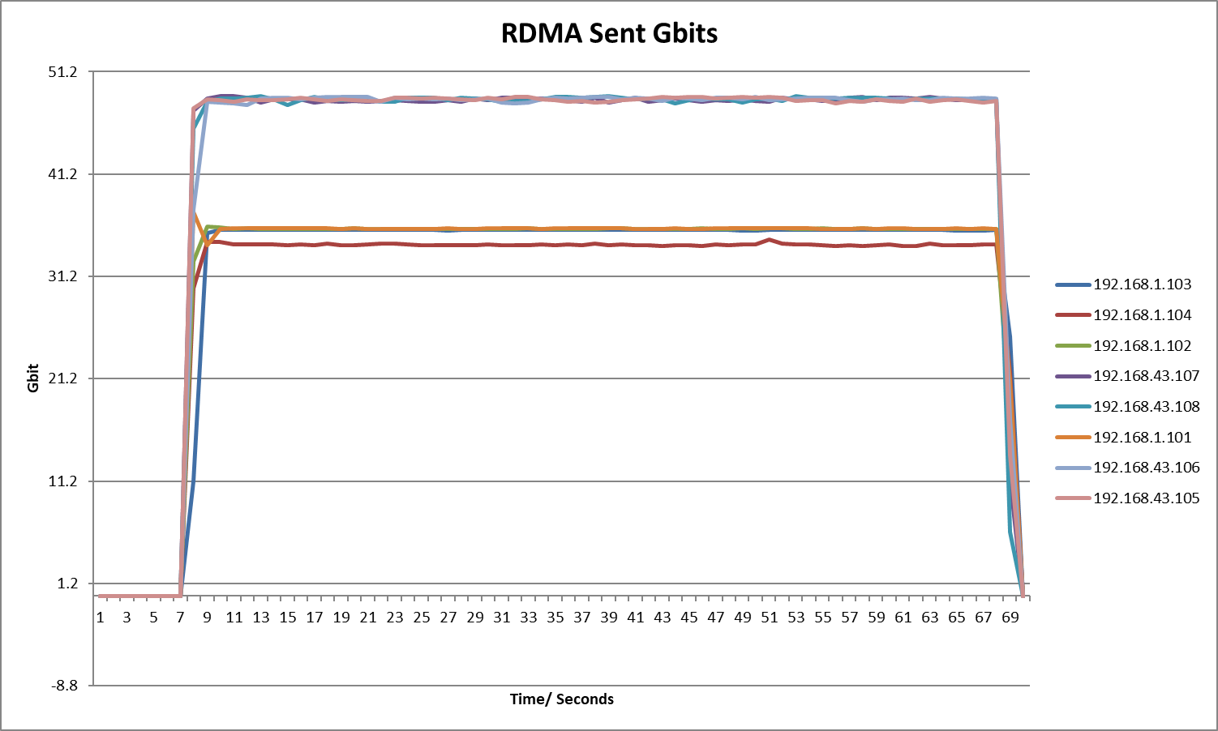
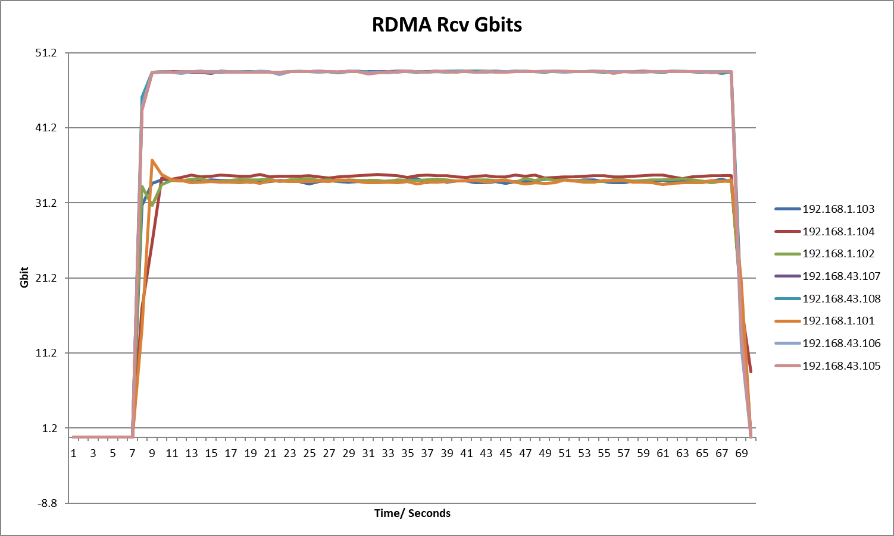
After deploying the fix
Same configuration as before
Gen2: 48Gbps goodput
Gen2: 48Gbps goodput
Gen1: 34Gbps goodput
Gen1: 34Gbps goodput
Aggregate goodput improved from 200Gbps to 316Gbps
Notes:
After deploying the fix, our experiment results match theory analysis.

Slide 58
Other Problems Found
PFC and MACsec
Different switches have no agreement on whether PFC frames sent should be encrypted or what to do with arriving encrypted PFC frames
Slow receiver due to loopback RDMA traffic
Loopback RDMA traffic and inter-host RDMA traffic cause host congestion
Fast Memory Registration (FMR) hidden fence
In sK-RDMA, the send queue consists of many FMR/Send pairs
The NIC processes the FMR request only after the completions of previously posted requests

Slide 59
Lessons and Open Problems
Failovers are very expensive for RDMA
Host network and physical network should be converged
Switch buffer is increasingly important and needs more innovations
Cloud needs unified behavior models and interfaces for network devices
Testing new network devices is critical and challenging

Slide 60
Lessons and Open Problems
Failovers are very expensive for RDMA
Host network and physical network should be converged
Switch buffer is increasingly important and needs more innovations
Cloud needs unified behavior models and interfaces for network devices
Testing new network devices is critical and challenging

Slide 61
Lessons and Open Problems
Failovers are very expensive for RDMA
Host network and physical network should be converged
Switch buffer is increasingly important and needs more innovations
Cloud needs unified behavior models and interfaces for network devices
Testing new network devices is critical and challenging

Slide 62
Lessons and Open Problems
Failovers are very expensive for RDMA
Host network and physical network should be converged
Switch buffer is increasingly important and needs more innovations
Cloud needs unified behavior models and interfaces for network devices
Testing new network devices is critical and challenging

Slide 63
Lessons and Open Problems
Failovers are very expensive for RDMA
Host network and physical network should be converged
Switch buffer is increasingly important and needs more innovations
Cloud needs unified behavior models and interfaces for network devices
Testing new network devices is critical and challenging

Slide 64
Thank You!

